Slide 1
Parallel Processing with RSUBMIT

Slide 2

Stu Sztukowski Analytic Consultant in SAS US Professional Services
Primary focuses: Forecasting & Visualization
https://linkedin.com/in/StatsGuy stu.sztukowski@sas.com
I love cars, fixing things, repurposing old electronics for useless tasks, and teaching/mentoring

Slide 3
What is RSUBMIT?
Parallelize One Dataset
Viya Parallel Processing
Conclusion, Q&A

Slide 4
Parallelized Programs with RSUBMIT
Faster run time
Effective resource use
Harder to debug

Slide 5
The Basic RSUBMIT Syntax for Parallel Processing
options autosignon=yes
noconnectwait
noconnectpersist
sascmd='!sascmd -nonews -nonotes'
;
rsubmit inheritlib=(mylib) remote=worker1;
<code>;
endrsubmit;
rsubmit inheritlib=(mylib) remote=worker2;
<code>;
endrsubmit;
waitfor _ALL_;
<code>;

Slide 6
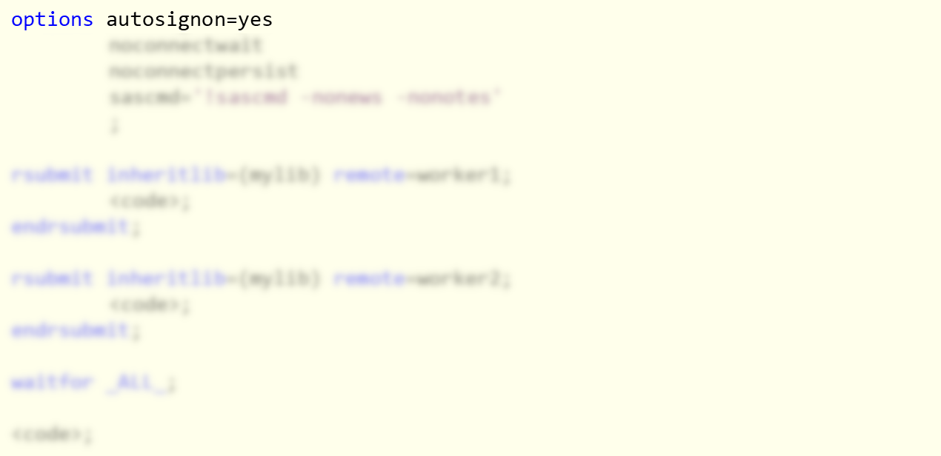
The Basic RSUBMIT Syntax for Parallel Processing
Automatically start new parallel SAS sessions with your current credentials.

Slide 7
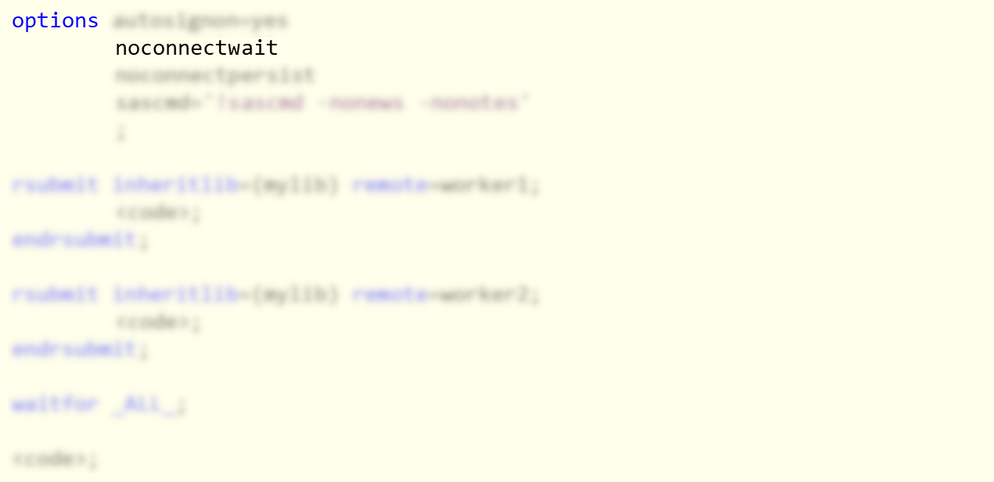
The Basic RSUBMIT Syntax for Parallel Processing
Run all RSUBMIT sessions in parallel. Don’t run them one-by-one.

Slide 8
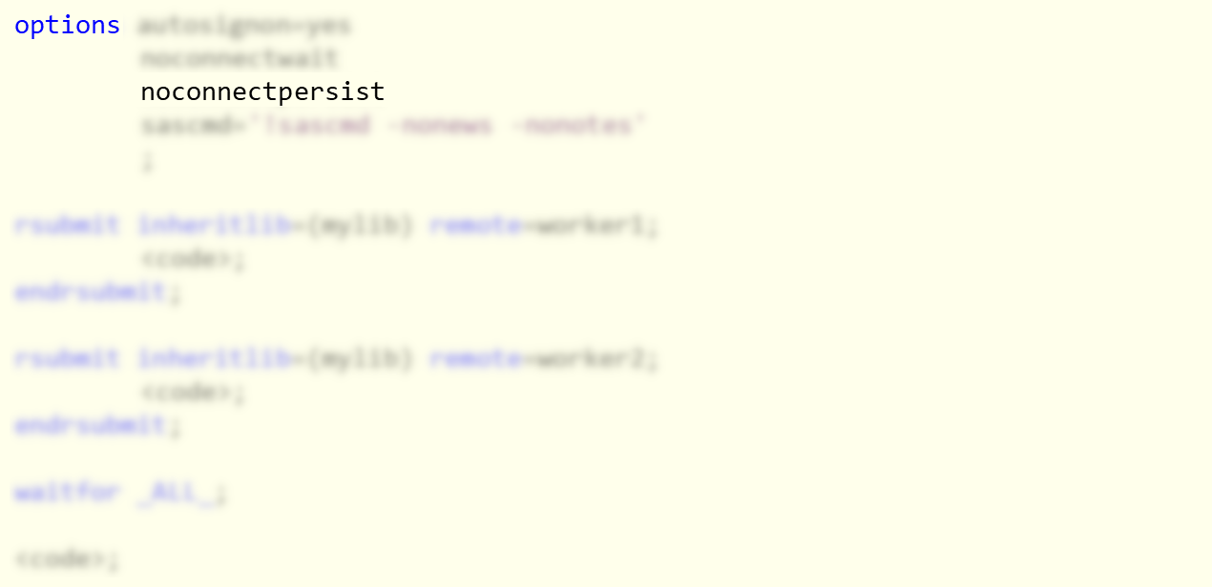
The Basic RSUBMIT Syntax for Parallel Processing
Sign off as soon as the parallel session finishes.
If you plan on calling RSUBMIT multiple times in a program, omit this option and sign off manually at the end with signoff.

Slide 9
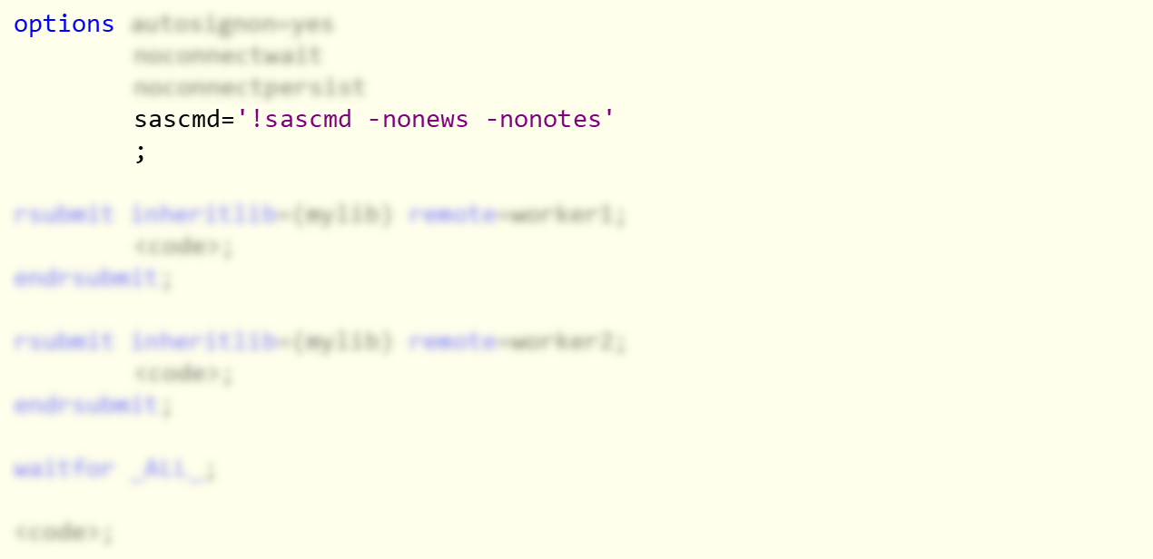
The Basic RSUBMIT Syntax for Parallel Processing
Sign on to the RSUBMIT SAS session using the SAS command that was used to start your main session.

Slide 10
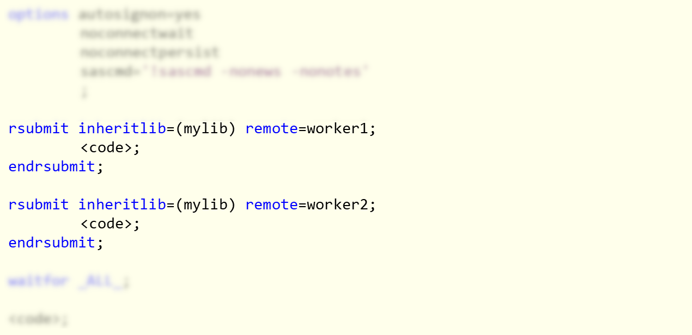
The Basic RSUBMIT Syntax for Parallel Processing
Start parallel sessions identified as “worker1” and “worker2.” Automatically assign the “mylib” library from the main session.
SAS code and macro calls between rsubmit and endrsubmit are executed in the parallel session, including code from %include.
Open code, such as %let, is executed in the main session.

Slide 11
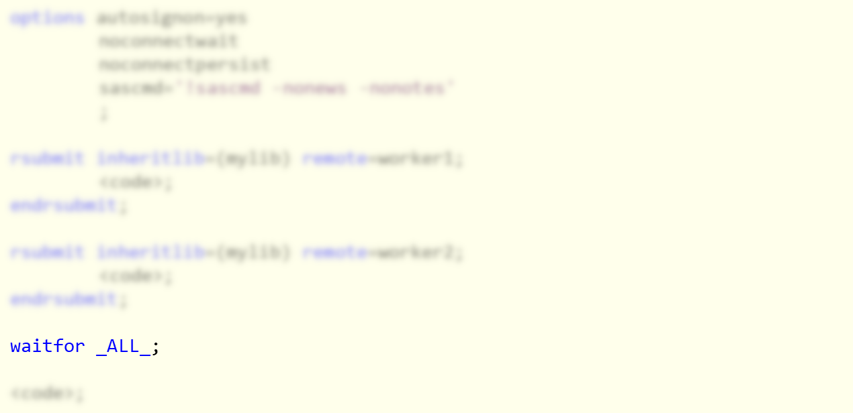
The Basic RSUBMIT Syntax for Parallel Processing
Wait for all workers to complete their jobs before continuing in the main session.
You can optionally specify to wait for individual workers and add session timeouts.

Slide 12
The WORK directory
You can’t inherit WORK directly but…
ERROR: The SAS system library WORK may not be reassigned.
NOTE: Subsequent lines will be ignored until ENDRSUBMIT.
ERROR: Remote submit to WORKER1 canceled.
libname workdir "%sysfunc(getoption(work))";
rsubmit inheritlib=(workdir);
data workdir.cars;
set sashelp.cars;
run;
endrsubmit;
Notes:
Flash once

Slide 13
What is RSUBMIT?
Parallelize One Dataset
Viya Parallel Processing
Conclusion, Q&A

Slide 14
Parallel Processing One Dataset with RSUBMIT
Strategy
Split data evenly into unique rows
Run your code on data splits with parallel workers
Wait for all workers to complete
Combine the results from all workers

Slide 15
Step 1: Split
Find your split points
%macro parallel(workers=);
%let dsid = %sysfunc(open(sashelp.cars));
%let n = %sysfunc(attrn(&dsid., nlobs));
%let rc = %sysfunc(close(&dsid.));
%do w = 1 %to &workers.;
%let firstobs = %sysevalf(&n-(&n/&workers.)*(&workers.-&w+1)+1, floor);
%let obs = %sysevalf(&n-(&n/&workers.)*(&workers.-&w.), floor);

Slide 16
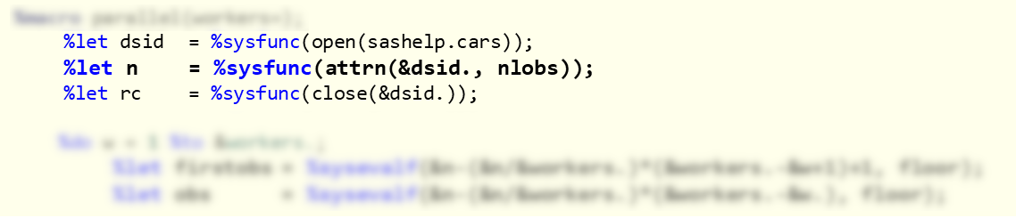
Step 1: Split
Find your split points
Get the total number of rows of a dataset and store it into macro var &n.

Slide 17
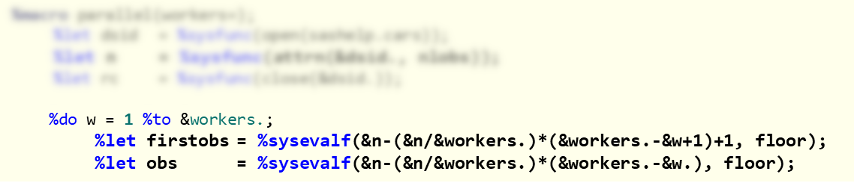
Step 1: Split
Find your split points
Determine start/end row for each worker.

Slide 18
Step 2: Run
Tell each worker what they’re working on
%syslput _USER_ / remote=worker&w.;
rsubmit remote=worker&w. inheritlib=(workdir);
data workdir._cars_&w.;
set sashelp.cars(firstobs=&firstobs. obs=&obs. cntllev=rec);
run;
endrsubmit;
%end;
For each worker, read only the assigned observations and do not lock the dataset. Alternative: Create a subset dataset of the primary dataset.
Notes:
Flash twice

Slide 19
Step 3: Wait
Sit back, relax, and wait
waitfor _ALL_;
…that’s pretty much it here

Slide 20
Step 4: Combine
Put it all together
data cars;
set _cars_:;
run;
It’s a good idea to run PROC DATASETS to clean up the temporary files once completed

Slide 21
%macro parallel(workers=);
%let dsid = %sysfunc(open(sashelp.cars));
%let n = %sysfunc(attrn(&dsid., nlobs));
%let rc = %sysfunc(close(&dsid.));
libname workdir "%sysfunc(getoption(work))";
%do w = 1 %to &workers.;
%let firstobs = %sysevalf(&n-(&n/&workers.)*(&workers.-&w+1)+1, floor);
%let obs = %sysevalf(&n-(&n/&workers.)*(&workers.-&w.), floor);
%syslput _USER_ / remote=worker&w.;
rsubmit remote=worker&w. inheritlib=(workdir);
data workdir._cars_&w.;
set sashelp.cars(firstobs=&firstobs. obs=&obs. cntllev=rec);
run;
endrsubmit;
%end;
waitfor _ALL_;
data cars;
set _cars_:;
run;
%mend;

Slide 22
Case Study
6 Cores
43GB RAM
500GB WORK space
7M Rows
28 Columns
PROC GEOCODE (Street Level, USA)
PROC GINSIDE
1 Worker
2 Hours, 19 minutes
18 Minutes
6 Workers
25 Minutes
3 Minutes

Slide 23
What is RSUBMIT?
Parallelize One Dataset
Viya Parallel Processing
Conclusion, Q&A

Slide 24
Parallel Processing in CAS
Rows are distributed among workers
Data Step is natively multithreaded
CAS actions are parallel-designed
1
2
3
4
5
6
7
8
9
RSUBMIT still works, but you can use create_parallel_session() in CASL
7
8
9
1
2
3
4
5
6

Slide 25
The Multithreaded Data Step
Threads are independent of each other
Think of every data step as many little data steps
1234
Lag, sum statements, and other row-dependent operations must be used carefully outside of by-groups

Slide 26
What is RSUBMIT?
Parallelize One Dataset
Viya Parallel Processing
Conclusion, Q&A

Slide 27
Examples and Macro Code
https://github.com/stu-code/SAS-rsubmit-examples

Slide 28




Step 1: Split
Find your split points
Determine start/end row for each worker.
Start Row
End Row
1
100 – $(\frac{100}{2})$(2-1+1)+1
= 100-100+1
= 1
100 – $(\frac{100}{2})$(2-1)
= 50
Worker
2
100 – $(\frac{100}{2})$(2-2+1)+1
100 – $(\frac{100}{2})$(2-2) = 100
= 100-50+1
= 51

Slide 29
By-Group Processing
The First By-Group = Most Important
data casuser.want;
set casuser.bigtable;
by origin model;
run;
Asia
Euro
USA
TSX
TL
…
328i Golf
…
Alero 300
…
Origin has three levels and may not use all available servers

Slide 30
By-Group Processing
The First By-Group = Most Important
TSX 300
TL …
328i …
Golf …
Alero …
data casuser.want;
set casuser.bigtable;
by model origin;
run;
Asia USA
Asia …
Euro …
Euro …
USA …
Model has many levels and will use all available servers

